Slide 1


Replicating findings from a longitudinal analysis of allostatic load among midlife women -------------
Sara O’Brien
BIOS669 Final Project

Slide 2
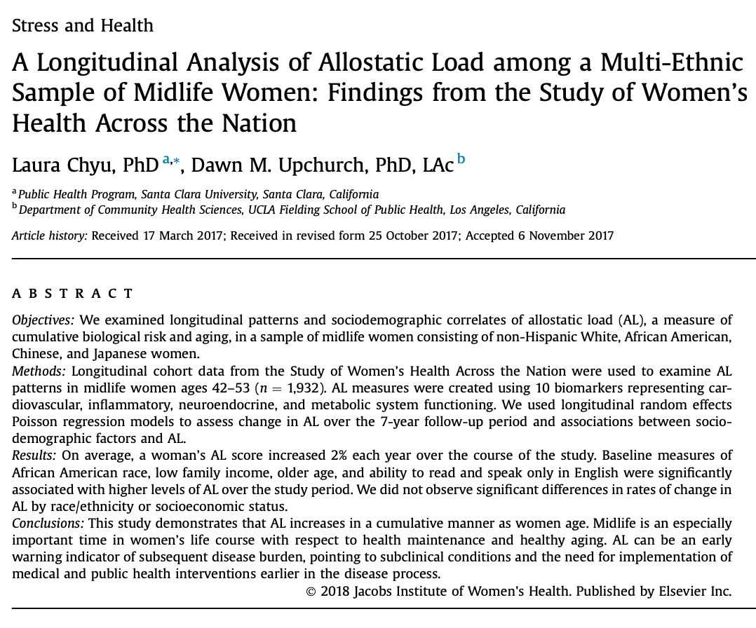
OBJECTIVE
Reproduce Table 1 and Figure 1 from Chyu and Upchurch’s original manuscript on allostatic load over time in a multi-ethnic cohort.
Notes:
Allostatic load (AL), a measure of cumulative biological risk and aging, assesses the impact of environmental and social stressors on multiple physiological systems in the body, and elucidates possible pathways by which these stressors translate into health outcomes and disparities
AL often reflects subclinical dysregulation, and as such, can potentially be used as an early warning indicator of disease risk. AL is associated with increased risk for mortality, cardiovascular disease, diabetes, higher pain scores, and decreased physical and cognitive function
One objective of this study was to examine how AL changes over time among midlife women
Findings: On average, a woman's AL score increased 2% each year over the course of the study. This study demonstrates that AL increases in a cumulative manner as women age. Midlife is an especially important time in women's life course with respect to health maintenance and healthy aging. AL can be an early warning indicator of subsequent disease burden, pointing to subclinical conditions and the need for implementation of medical and public health interventions earlier in the disease process.

Slide 3
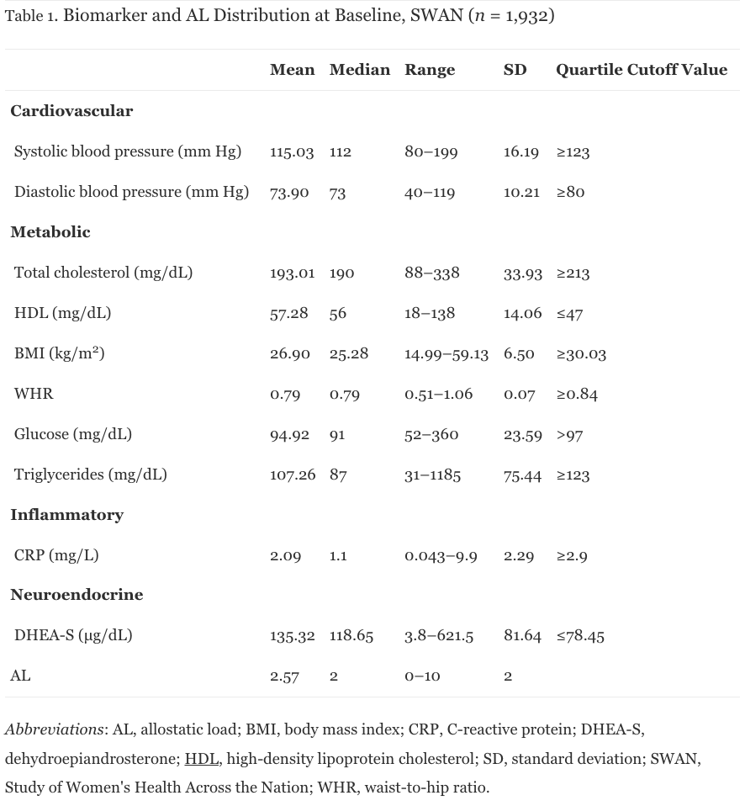
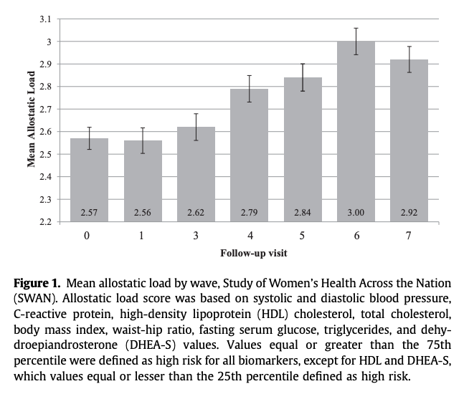
ORIGINAL TABLE & FIGURE

Slide 4
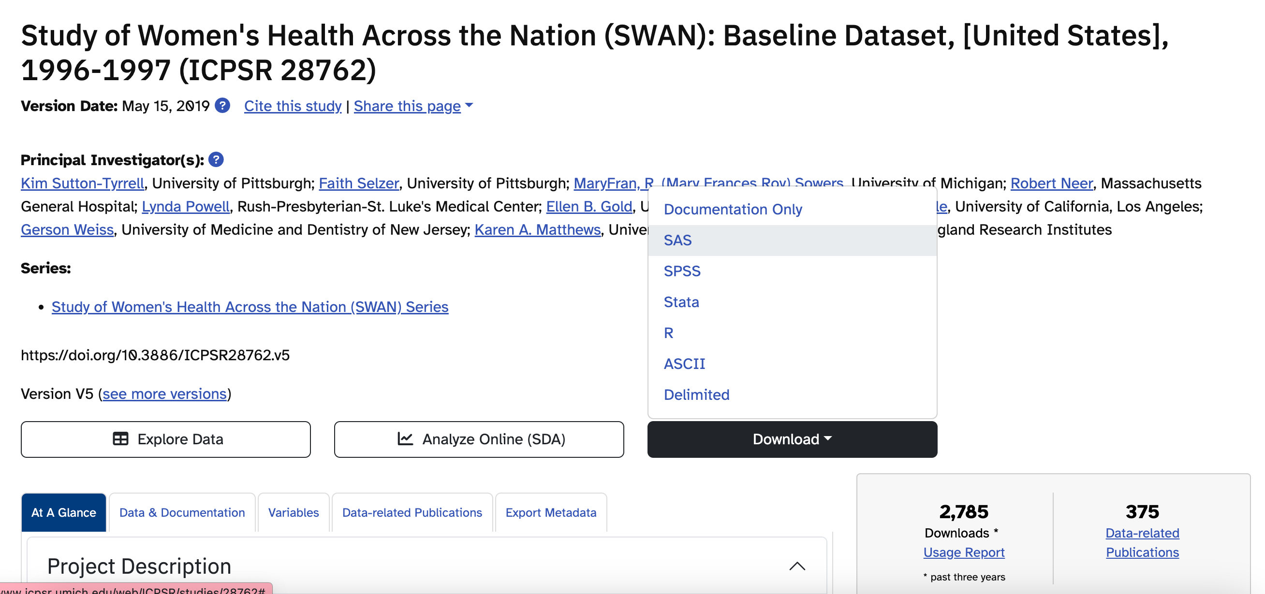
DATA SOURCE
Notes:
ICPSR, a research consortium, has all datasets for SWAN available for download as SAS transport files. These are SAS datasets that were exported using the CPORT procedure. As such, when I uploaded them to SAS OD, I imported them using PROC CIMPORT.

Slide 5
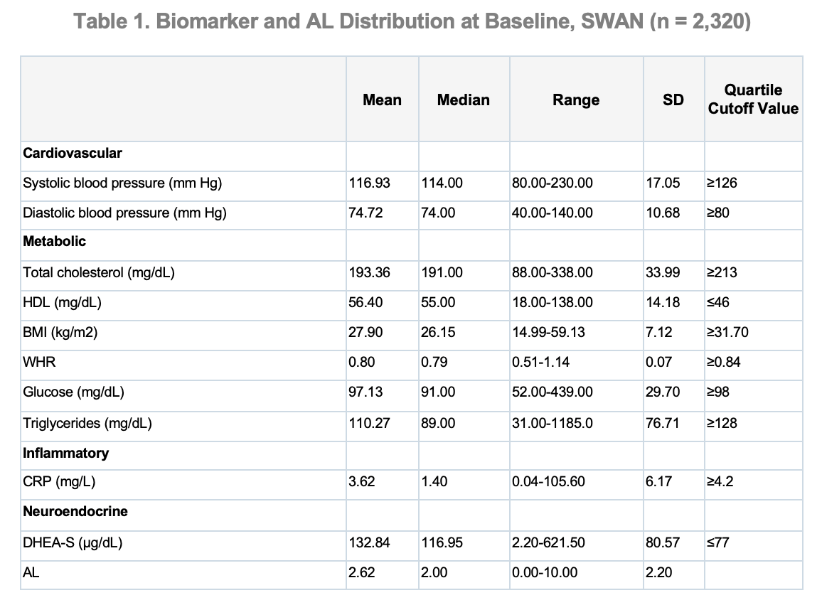
TABLE 1 REPLICATION
Notes:
One important difference between my replications and the original tables/figures is that I only had access to data which was de-identified for public use. In the paper, their final analytic subset excluded all participants at the NJ site because of a low retention rate, but I could not exclude these women because I did not have a site variable. As such, the replications are not exact in terms of summary statistics, but they are very similar.
Determine the quantile cutoff values at baseline using PROC UNIVARIATE and save these results in a usable dataset using ODS OUTPUT, data steps, and PROC TRANSPOSE.
Store cutoff values in macros using a data step and CALL SYMPUTX.
Calculate allostatic load scores at each visit using a macro data step and condition if statements that referenced the macro quantile cutoff variables.
Check derived variables using PROC FREQ and with a PROC PRINT of the first 20 observations, their respective biomarker values, the cutoff values, and their AL scores, and checking that for this selected subset, AL scores seem to be calculated appropriate.
Create the final analytic dataset using a data step and merge.
Prepare a dataset for Table 1, pulling from a PROC UNIVARIATE with summary statistics, which was exported to a SAS dataset and transposed.
Hard code new lines of data in preparation for PROC REPORT.
Use PROC REPORT to turn the table 1 dataset into a replication of Table 1 from the original manuscript, using a compute block for style techniques and define statements for additional formatting.

Slide 6
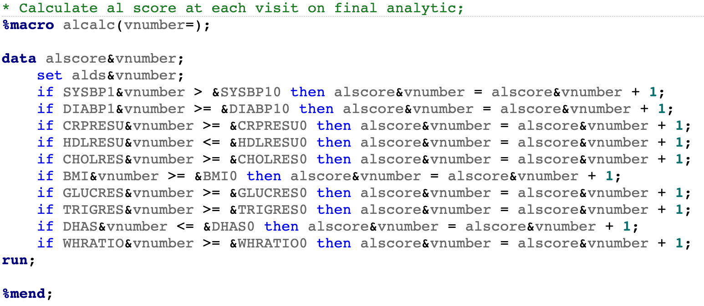
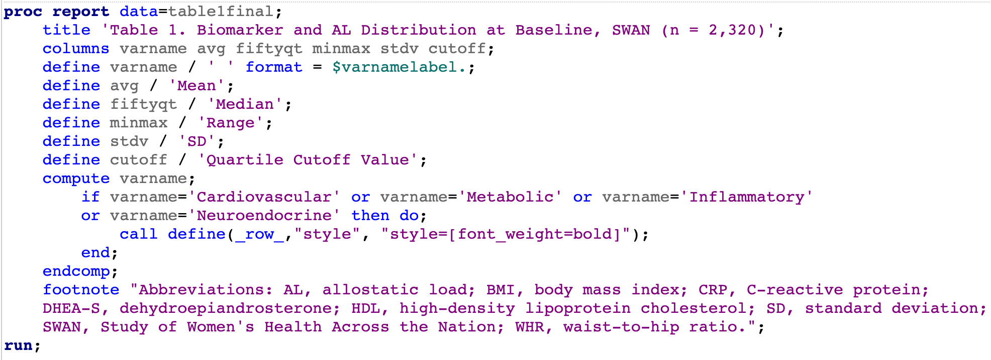
TABLE 1 REPLICATION
Notes:
Determine the quantile cutoff values at baseline using PROC UNIVARIATE and save these results in a usable dataset using ODS OUTPUT, data steps, and PROC TRANSPOSE.
Store cutoff values in macros using a data step and CALL SYMPUTX.
Calculate allostatic load scores at each visit using a macro data step and condition if statements that referenced the macro quantile cutoff variables.
Check derived variables using PROC FREQ and with a PROC PRINT of the first 20 observations, their respective biomarker values, the cutoff values, and their AL scores, and checking that for this selected subset, AL scores seem to be calculated appropriate.
Create the final analytic dataset using a data step and merge.
Prepare a dataset for Table 1, pulling from a PROC UNIVARIATE with summary statistics, which was exported to a SAS dataset and transposed.
Hard code new lines of data in preparation for PROC REPORT.
Use PROC REPORT to turn the table 1 dataset into a replication of Table 1 from the original manuscript, using a compute block for style techniques and define statements for additional formatting.

Slide 7
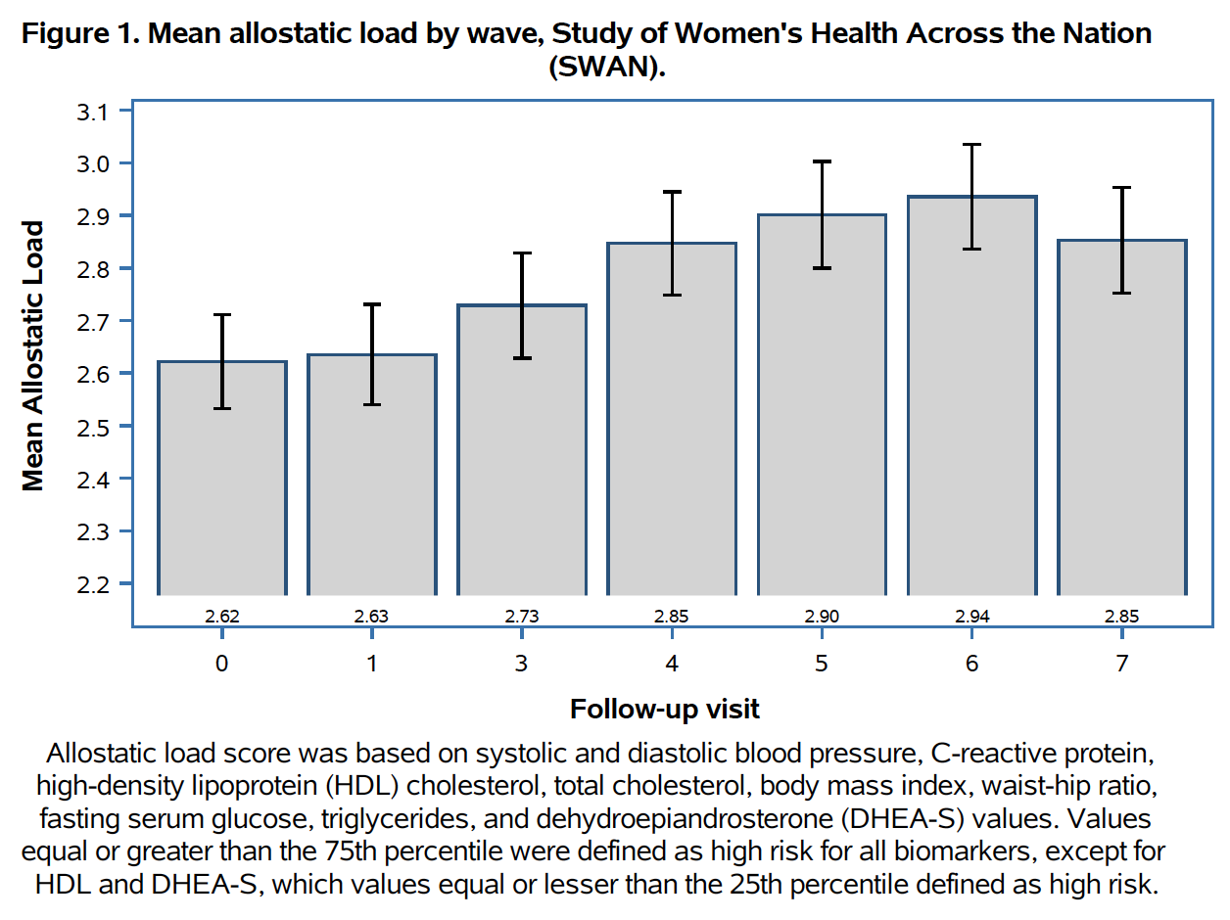
FIGURE 1 REPLICATION
Notes:
Use PROC MEANS to get summary statistics, including confidence intervals, for Figure 1.
Using data steps, merge, and the statistics saved from PROC MEANS, prepare data for visualization.
Create visualization in PROC SGPLOT, using both vbar and highlow to stack the vertical bar graphs and error bars.

Slide 8
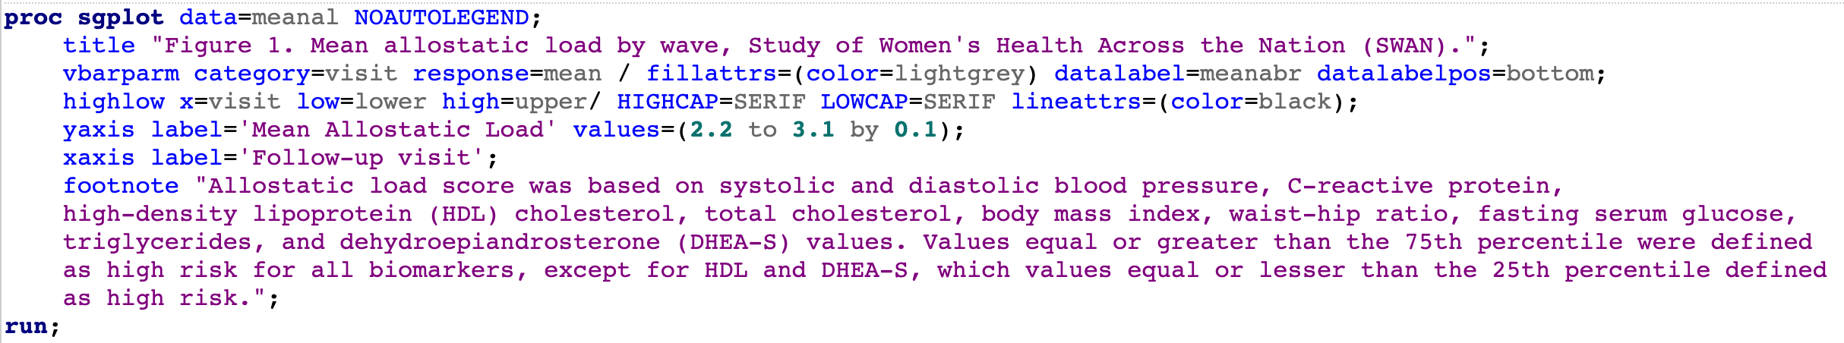
FIGURE 1 REPLICATION
Notes:
Use PROC MEANS to get summary statistics, including confidence intervals, for Figure 1.
Using data steps, merge, and the statistics saved from PROC MEANS, prepare data for visualization.
Create visualization in PROC SGPLOT, using both vbar and highlow to stack the vertical bar graphs and error bars.

Slide 9
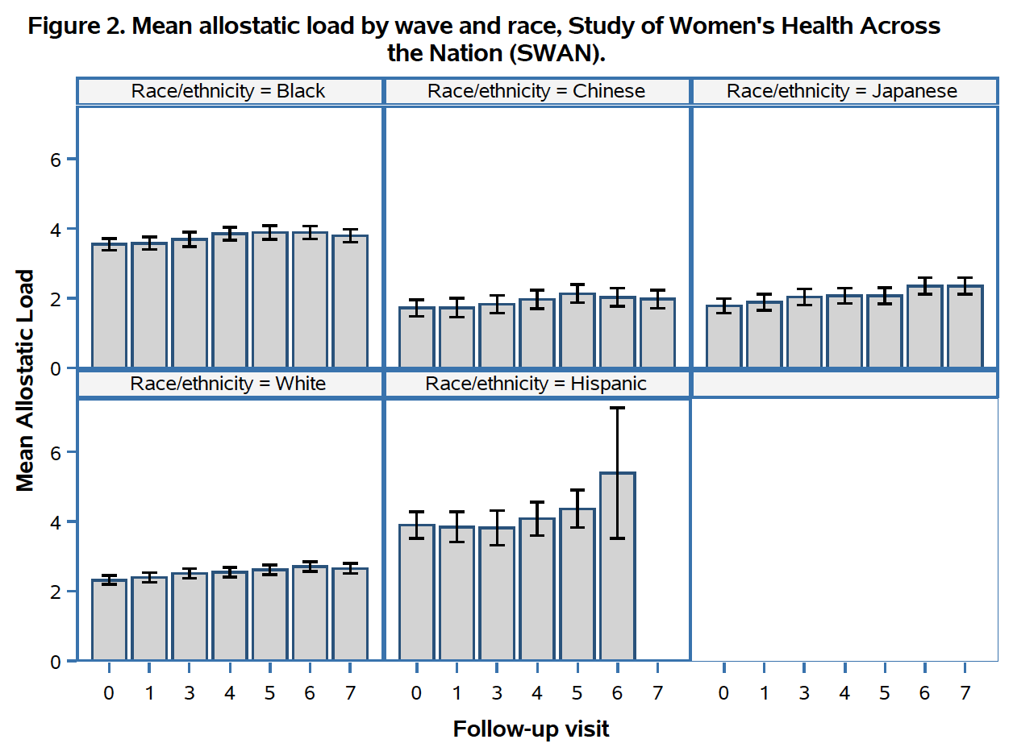
FIGURE 2 – NEW FIGURE
Notes:
I decided to create Figure 2, an extension of Figure 1 with group by race, since allostatic load has been shown to result in worse health outcomes for marginalized populations (https://doi.org/10.1038/s41598-022-20987-x). Figure 2 displays an expected trend of racial disparity across AL, with Hispanic and Black Americans having consistently higher allostatic loads on average than White and Asian women.
Pulled in the race variable from baseline and added to the analytic dataset using PROC SQL to produce a visualization similar to Figure 1 with grouping by race.
Created Figure 2 (Figure 1 with mean by visit and race) using PROC SGPANEL to see distribution of AL scores over time by race.

Slide 10
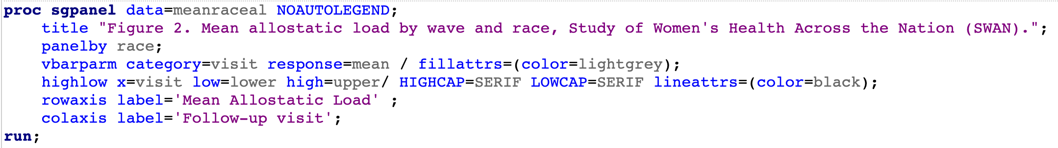
FIGURE 2 – NEW FIGURE
Notes:
Pulled in the race variable from baseline and added to the analytic dataset using PROC SQL to produce a visualization similar to Figure 1 with grouping by race.
Created Figure 2 (Figure 1 with mean by visit and race) using PROC SGPANEL to see distribution of AL scores over time by race.
I decided to create Figure 2, an extension of Figure 1 with group by race, since allostatic load has been shown to result in worse health outcomes for marginalized populations (https://doi.org/10.1038/s41598-022-20987-x). Figure 2 displays an expected trend of racial disparity across AL, with Hispanic and Black Americans having consistently higher allostatic loads on average than White and Asian women.

